Slide 1

Session 4: Off-page Optimization

Slide 2


Off- page Optimization
Helps:
Gain relevant traffic
Link-building
 | Improve Website rank on
 | SERPs

Slide 3
Types of Links
These links are automatically gained when relevant content is found.
Natural Links
Manual Links
These links are built deliberately using multiple methods.
Self - Created Links
These are forced links gained by adding backlinks.

Slide 4
Types of Off-page Optimization
Engage in Social Media Platforms
Use Social Bookmarking Sites
Participate
in Forums
Submit
Video
Publish Appealing Content
Reach out to Influencers
Submit Blog Directory
Submit Image
Reach out to Popular Bloggers
Become Guest Author
Submit Infographic
Share Documents
Submit Article

Slide 5
Common Off-Page Mistakes
Directory Submission
Buying Links
Unmoderated comments resulting in spam
Off-site Blog

Slide 6

Domain Authority (DA) and Page Authority (PA)
No-follow links
Moz
Ahrefs
Number of unique
domains linking to a page
Majestic
SEMrush
Domain name
301s and 302s
Popular SEO tools to measure DA
Factors to calculate PA score
Trust - worthiness of Websites linking to the page
Site structure and User Friendlin ess
Number of Linked Websites
Number of Unique Backlinks
Link Profile
Website Quality
Factors to calculate DA score

Slide 7
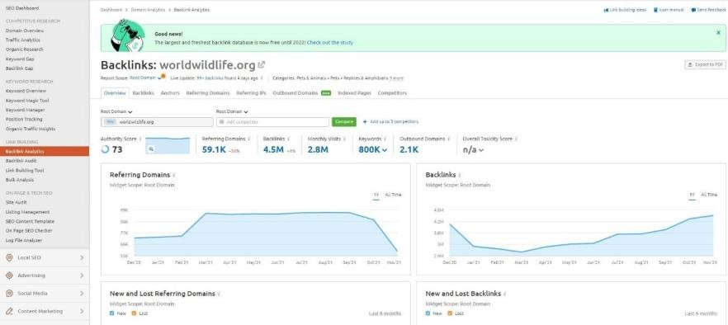
Backlink Analysis
Select sites for analysis
Select Backlink Analysis Tool
Collect information and perform analysis
Compare the results with competitor Websites
Backlink Analysis - Example
Steps to perform backlink analysis
Google Search Console
Moz Link Index tool
SEMrush Backlink Analytics tool
SEMrush Backlink Audit tool
Popular Backlink Analysis Tools

